Slide 1
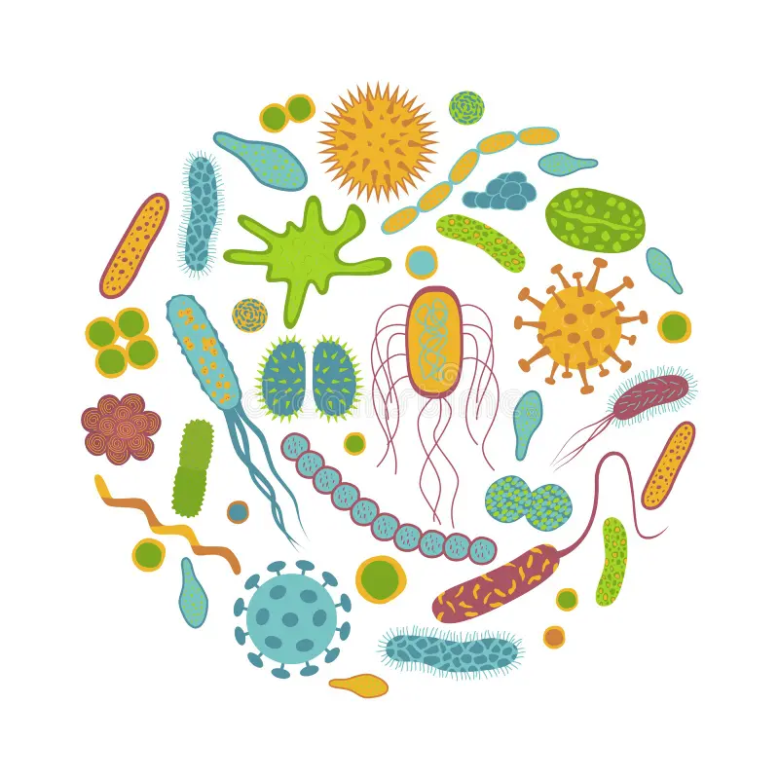


α and β diversity
Vincent Manzanilla

Slide 2

What is Biodiversity?
The variety and variability among living organisms on site, ecosystem and their interactions between them.
Diversity can be use to describe variations in several forms:
Genetic
Taxonomic
Funcional group (e.g. nitrogen-fixing)

Slide 3
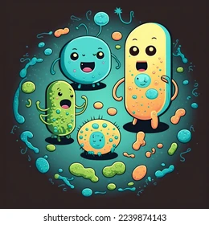
Why measuring Biodiversity?
Biodiversity
proxy
Ecosystem health
In general, diverse communities are believed to have increased stability, increased productivity, and resistance to invasion and other disturbances.

Slide 4
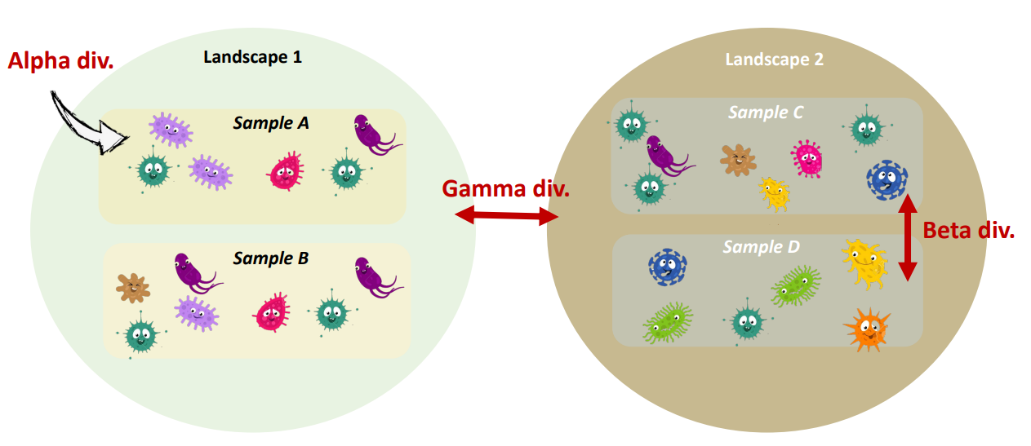
Alpha vs Beta vs Gamma Diversity (Whi4aker, 1972)
Alpha, beta and gamma diversity are three types of biodiversity measures described over a special scale

Slide 5
⍺-Biodiversity ?
α-diversity is local diversity, measured within a closed system
→ The diversity within an habitat of fixed size
α-biodiversity has two components
- Richness
- Evenness
→ Follow the evolution of populations over time, but also to compare studied stations

Slide 6
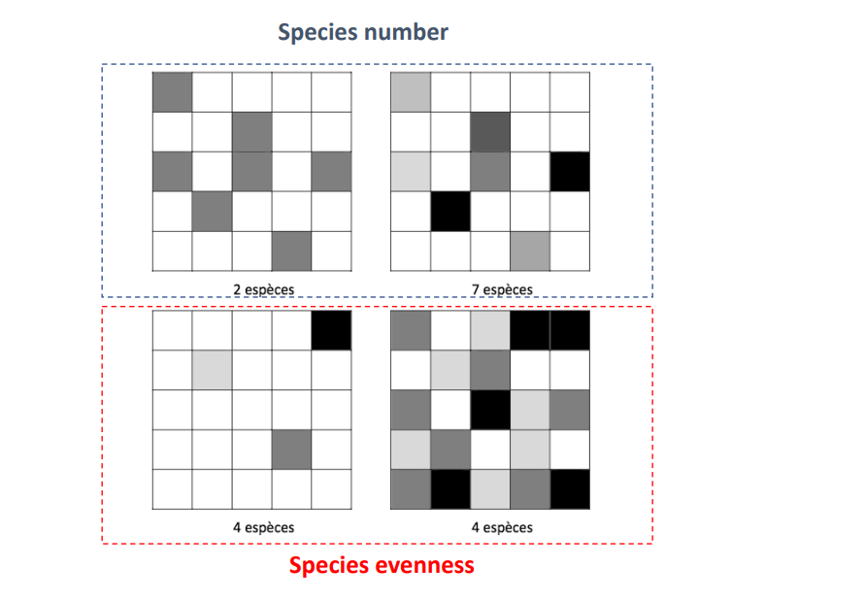
Components of Diversity
https://ericmarcon.github.io/MesuresBioDiv2/chap-Notions.html

Slide 7
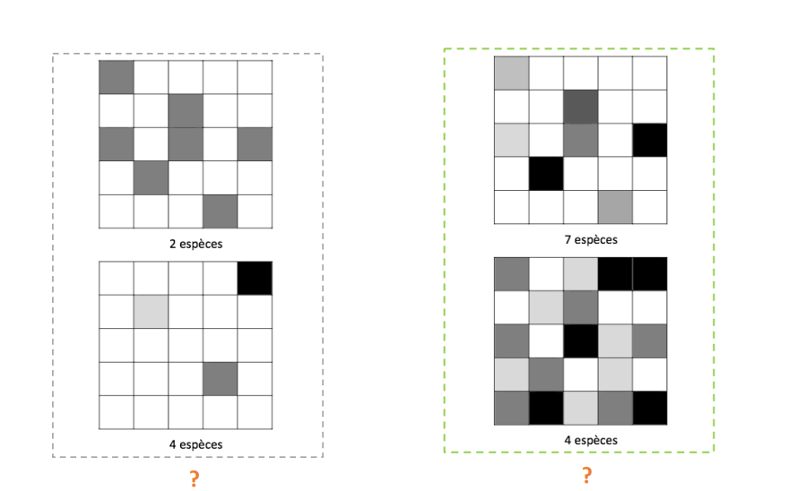
Two components are necessary for describing diversity
- Richness
- Evenness

Slide 8
Components of Diversity - Definition
Specific Richness (S) = The measurement of the number of species present in a location/studied system
The more species present, the richer sample is
Gives equal weight to species which have many/few individuals
Evenness (equitability) = Relative population of each species
Species represented by many individuals or by few ones do not give the same contribution Evenness index is independent of Richness!!

Slide 9
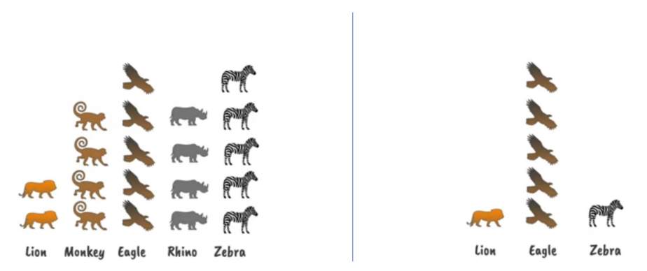
Higher biodiversity Lower biodiversity
Wide range of species = high richness
Relatively equal proportion = high evenness
Few species = low richness
Unequal proportion = low evenness

Slide 10
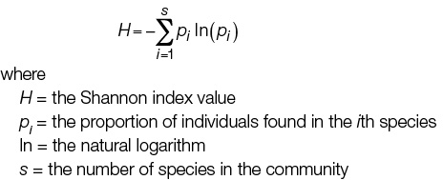
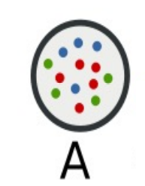
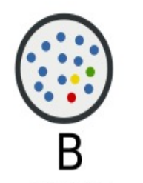
Shannon index of Diversity
Species are considered as equidistant (= do not consider species relatedness)

Slide 11
Calculate the Shannon diversity index for A and B
A: consists of 3 species, of which 4 green, 5 red & 4 blue
B consist of 4 species, of which 1 green, 1 red, 1 yellow & 11 blue

Slide 12


Calculate the Shannon diversity index for A and B
A: consists of 3 species, of which 4 green, 5 red & 4 blue
B consist of 4 species, of which 1 green, 1 red, 1 yellow & 11 blue

Slide 13

Calculate the Shannon diversity index for A and B
Shannon value: Influenced by richness
H is generally between 1.5 – 4
H gets higher when :
- There are more species
- There is greater evenness
B consist of 4 species, of which 1 green, 1 red, 1 yellow & 11 blue
A: consists of 3 species, of which 4 green, 5 red & 4 blue
B consist of 4 species, of which 1 green, 1 red, 1 yellow & 11 blue
A: consists of 3 species, of which 4 green, 5 red & 4 blue

Slide 14
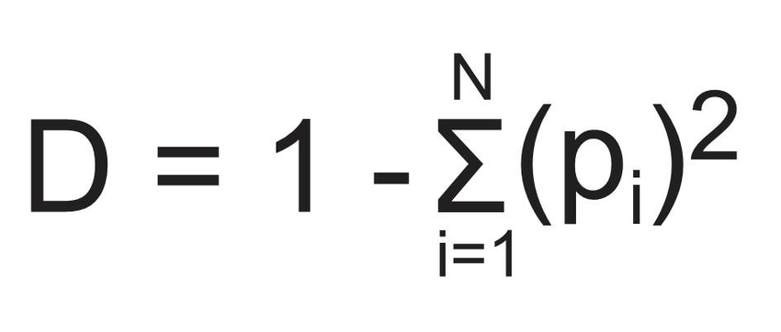


Simpson’s Index of Diversity
Idea : Indicates the taxa dominance and gives the probability of two individuals that belong to the same taxa being randomly chosen
A value of 0.7 … 2 sequences randomly selected have 70% chance to belong to the same OTU
Influenced by highly abundant Taxa
Greater weight on evenness
Range 0 to 1 (high)

Slide 15
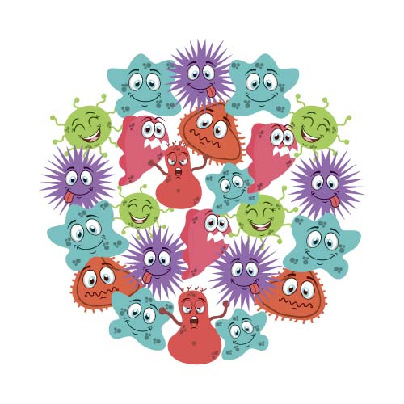
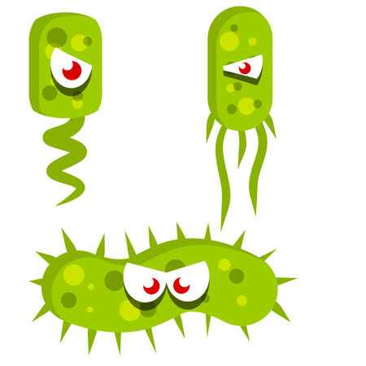
The closer the value to 1, the more diverse the habitat is
1
Infinite diversity
Hig sp. Diversity
0
No diversity
Low sp. Diversity
→ Few successful species in the habitat
→ Env stressful, few niches, few
organisms well adapted to env
→ Any change in env may have
serious effect on ecosystem
→ Great number of successful species, more stable ecosystem
→ Env is less likely to be Hostile
→ Complex food chain
→ Env change is less likely to
dammage the whole ecosystem

Slide 16


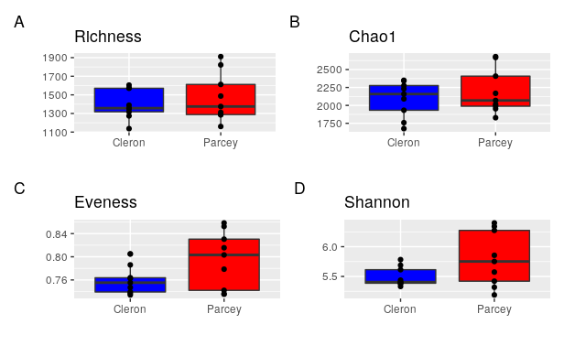
Diversity Estimators
Chao1 & ACE are non-parametric estimators of taxa richness
Chao1 & ACE are non-parametric estimators of taxa richness
Chao1 & ACE are non-parametric estimators of taxa richness
Chao1 estimates the total richness
Schao1 = the estimated richness
Sobs = the observed number of species
N1 = 1 the number of OTUs with only one sequence (i.e. “singletons”)
N2 > 1the number of OTUs with only two sequences (i.e. “doubletons”)

Slide 17

Diversity Estimators
Chao1 & ACE are non-parametric estimators of taxa richness
Chao1 & ACE are non-parametric estimators of taxa richness
Chao1 & ACE are non-parametric estimators of taxa richness
Chao1 estimates the total richness
Schao1 = the estimated richness
Sobs = the observed number of species
N1 = 1 the number of OTUs with only one sequence (i.e. “singletons”)
N2 > 1the number of OTUs with only two sequences (i.e. “doubletons”)

Slide 18
Diversity Estimators
Chao1 & ACE are non-parametric estimators of taxa richness
Chao1 & ACE are non-parametric estimators of taxa richness
Chao1 & ACE are non-parametric estimators of taxa richness
Chao1 estimates the total richness
Schao1 = the estimated richness
Sobs = the observed number of species
N1 = 1 the number of OTUs with only one sequence (i.e. “singletons”)
N2 > 1the number of OTUs with only two sequences (i.e. “doubletons”)

Slide 19
β diversity
Inter-sample comparison of the community composition
Measure of the similarities/dissimilarities between the samples according to specific criteria
e.g. Unifrac, Bray Curtis
Highlight structure by Ordination Plot in low dimensional space
e.g. PCoA, PCA, Db-RDA, Biplot
Test the different structures & identify main variables / taxa
e.g. Permanova, differential abundance

Slide 20
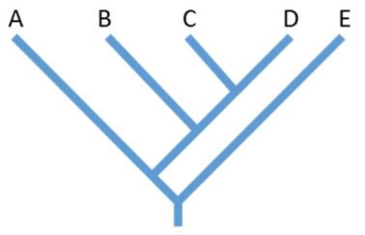
Overview of the Beta-analysis approach
Normalization
1
Raw
Data
Transformed
Data
Similarity
matrices

Slide 21
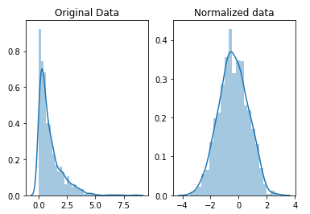
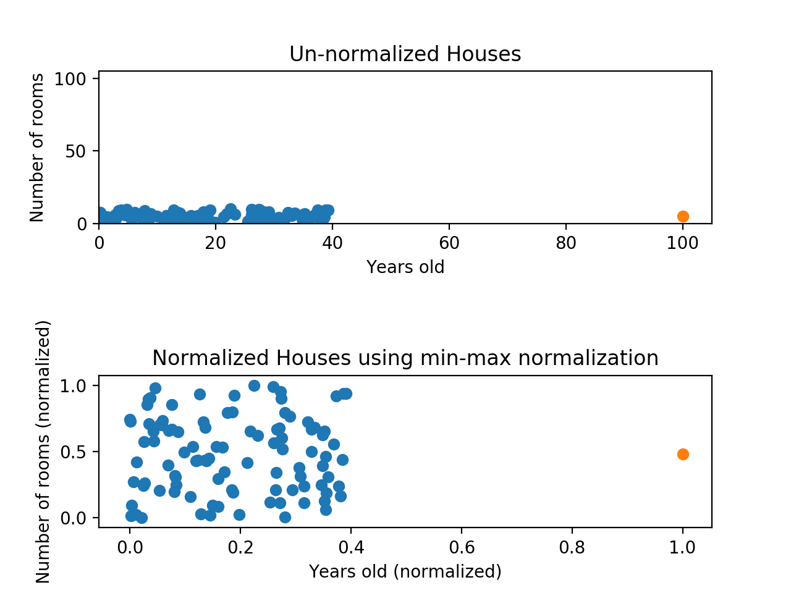
Normalization
Microbiome data often exhibit significant variance in sequencing depth among samples. Such variances, if unaccounted for, can skew the analysis and interpretation. Data normalization is crucial to account for this technical variation, ensuring that samples are comparable and results are robust.
Why transformation?
  To reduce the variation range (e.g. give low weight to extreme values)
  Correcting sparsity and over-dispersion

Slide 22
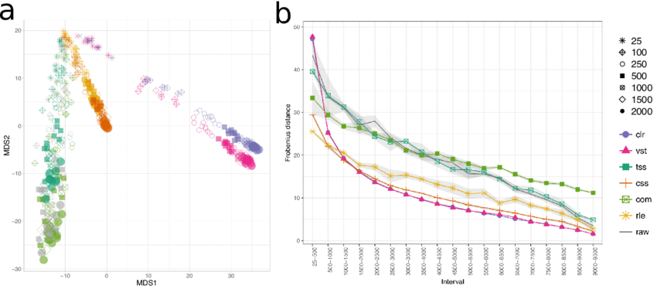
Normalization
Transformations that remove compositional artifacts (CLR) and variance stabilizing transformation (VST) result in substantially different patterns of correlation. A) Multidimensional scaling representation distances between correlation structures of varying size estimated from different normalization methods. These estimates are also compared to untransformed or raw count values (dark grey points). B) Distance between sub-samples of different sizes. Lines represent mean and grey ribbon represent standard deviation from the mean. (color scheme as in A)
https://doi.org/10.1101/406264

Slide 23
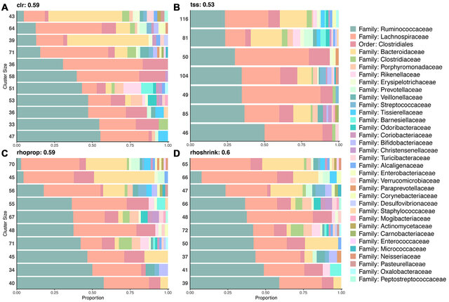
Normalization
The stacked bar plots represent the composition of OTUs in each cluster at the Family level. Numbers on the left axis represent the number of OTUs in each cluster. Numbers on the right axis represent the number of taxonomic groups at the order level are in each cluster. Clusters of OTUs after CLR transform produce more taxonomically homogeneous clusters than TSS.

Slide 24
Distance matrix
Distance Matrix
2
Raw
Data
Transformed
Data
Similarity
matrices

Slide 25
Distance matrix
Quantifying ecological resemblances between samples, including similarities (S) and dissimilarities (or distances), is the basic approach of handling multivariate ecological data
Two samples, which contain the same species with the same abundances, have the highest similarity, the similarity decreases with the differences in species composition
Ordination methods operate with distances or dissimilarities between samples
Ordination is a collective term for multivariate techniques which summarize a multidimensional dataset in such a way that when it is projected onto a low dimensional space, any intrinsic pattern the data may possess becomes apparent upon visual inspection (Pielou, 1984).
In ecological terms: Ordination summarizes community data (such as species abundance data: samples by species) by producing a low-dimensional ordination space in which similar species and samples are plotted close together, and dissimilar species and samples are placed far apart. Ideally and typically, dimensions of this low dimensional space will represent important and interpretable environmental gradients.

Slide 26
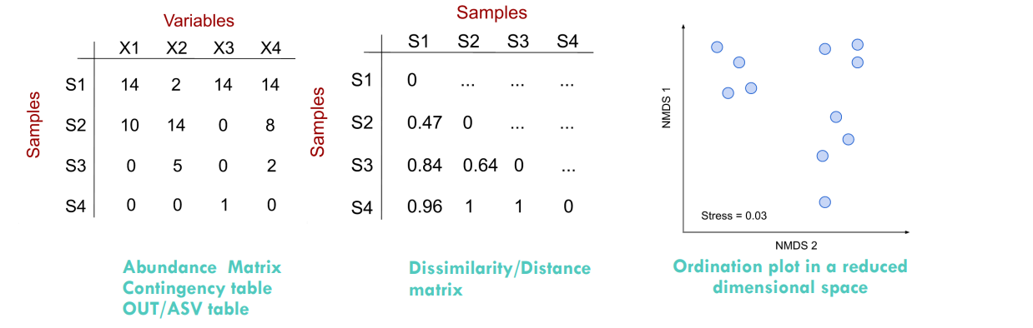
Distance matrix

Slide 27
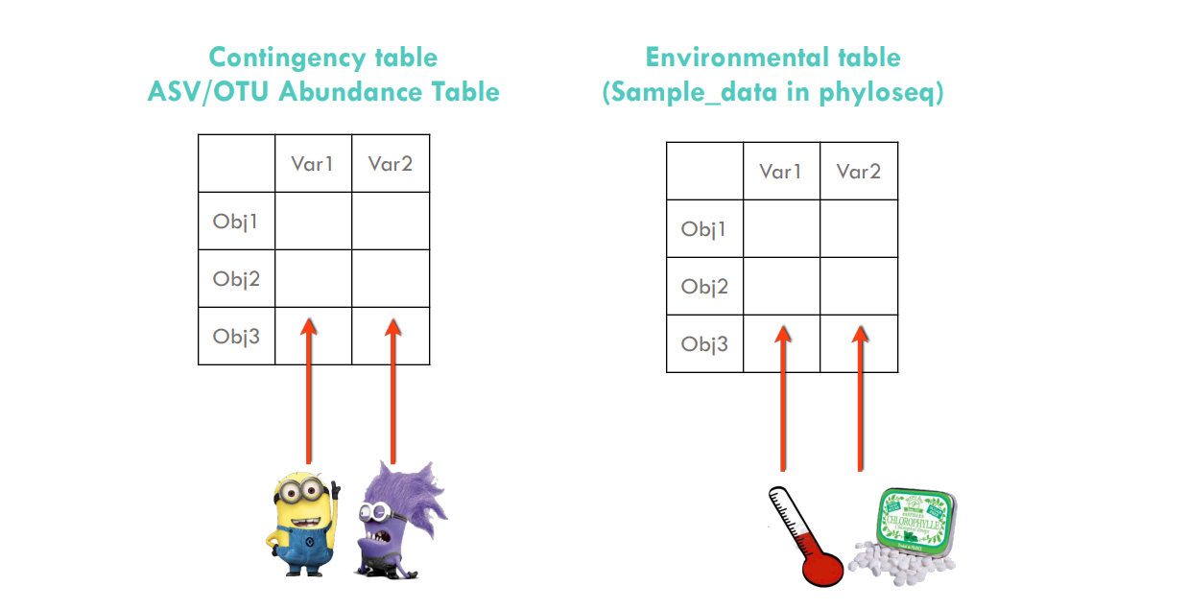
Distance matrix

Slide 28
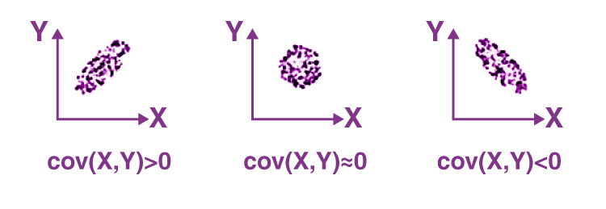
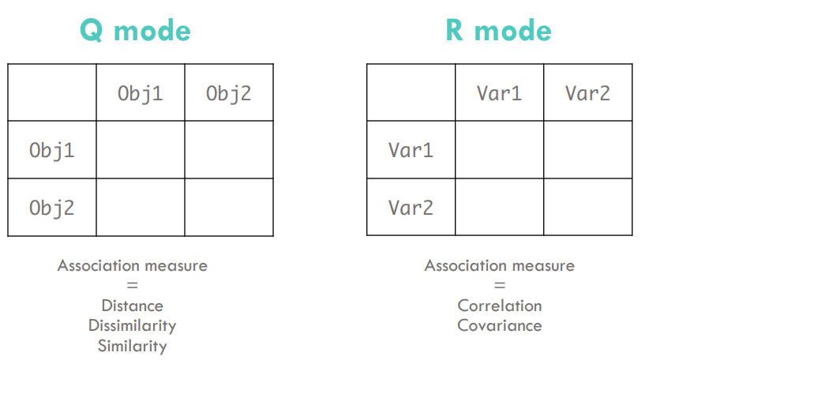
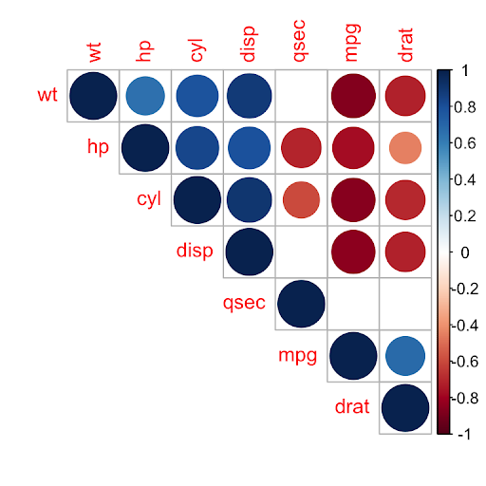
Distance matrix
Covariance:measures the total variation of two random variables from their expected values
When pairs of objects are compared, we talk about Q mode. We talk about R mode when variables are compared.
Correlation: the relationship between two variables in a data set.

Slide 29
Similarity : How do deal with Double-zeros? Co-absence
Species composition data are sparse matrix, which means that it contains lot of zeros, double zeros
Double zero” is a situation when certain species are missing in both compared community samples for which similarity/distance will be next calculated!
 | Sp A | Sp B | Sp C
Site 1 | 0 | 44 | 0
Site 2 | 11 | 50 | 0
Does not say anything about ecological similarity or difference between both samples.
Consider them as missing data!

Slide 30
Similarity : How do deal with Double-zeros? Co-absence
 | Sp A | Sp B | Sp C
Site 1 | 0 | 44 | 0
Site 2 | 11 | 50 | 0
Recommendation is to use dissimilarity indices or distance-based method that do not take into account the double zero as a resemblance!!!
Symmetrical vs. Asymmetrical indices
    Asymmetrical indices ignore the double-zeros (e.g. bray-Curtis, Weighted Unifrac)
    Symmetrical indices consider the double-zeros as important (PCA!)! (e.g. Euclidian without transformation)
Bray-Curtis and Hellinger distances may be better choices than Euclidean or Chi-square distances.
Legendre & Legendre (2012).

Slide 31
Questions you should ask yourself before choosing a dissimilarity/distance metric
Do I compare variables or objects? (R vs Q modes)
Do I use ASV/OTU/species variables or another type (e.g.; physico-chemical)? Asymmetrical Vs symmetrical dissimilarity or distance index
What type of data do I have? Binary Vs quantitative Vs multifactor
  Three broad categories of dissimilarity or distance index :
      for binary data (presence/absence)
      for quantitative data
      for a mix of numerical and categorical data (multifactor)

Slide 32
Most common dissimilarities/distance used for species data
Dissimilarities Distances | Taxonomic | Phylogenetic
Compositional (Binary) | Sorensen Jaccard Ochiai | Unweighted Unifrac PhyloSor
Structural (Quantitative) | Bray-Curtis Chord Hellinger Aitchison | Weighted Unifrac Allen

Slide 33
Distance
Distance | Key points
Euclidian | Highly impacted by the unit or scale of the descriptor Standardize if descriptors have not the same units
Hellinger | Particularly suited to species abundance data, this transformation gives low weights to variables with low counts and many zeros. Reduce the effects of values that are extremely large.
Bray-Curtis | Values range from 0 (maximum of similarity) to 1 Same sampling depth in each sample

Slide 34
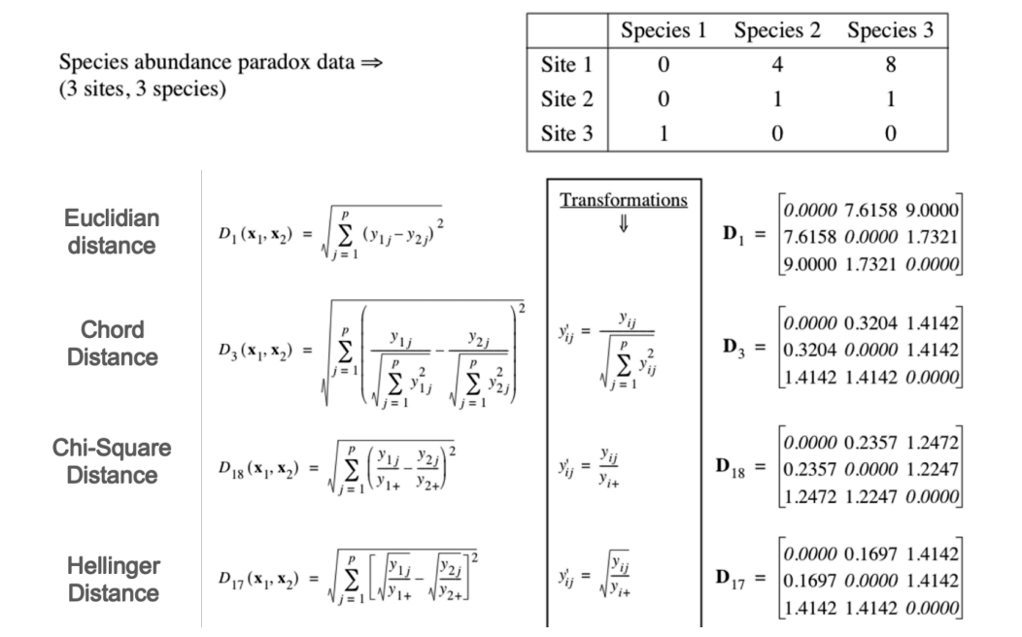
Choose the right distance/dissimilarity

Slide 35
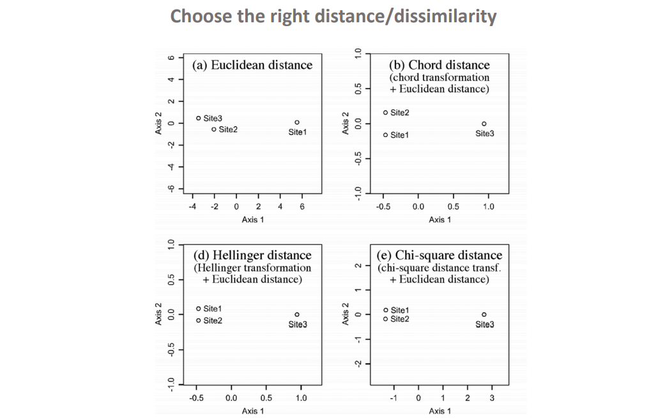

Slide 36
https://anf-metabiodiv.github.io/course-material/practicals/beta_diversity.html

